Slide 1
Introduction to data Analytics and data mining
Introduction and Course Overview.
Andrew McCarren,
L121 ext 8456
Andrew.mccarren@dcu.ie

Slide 2
Andrew McCarren
Associate Professor and Head of School
Scientific Centres:
Insight centre for Data Analytics
Science Foundation of Ireland Funded Investigator (Insight and Vista Milk)
Research areas:
Data analytics, Data Mining & Time series analytics
Sports Science, Health, Food industry & more
Director of analytics start-up and consultant.
20 years experience in Industry
Big Pharma, Electronic Engineering, Food and education.

Slide 3
Lab Test
Can you see the lecturer?
Can you see the content boards?
Have you a TA in your room?

Slide 4
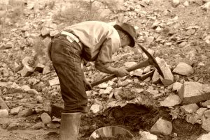

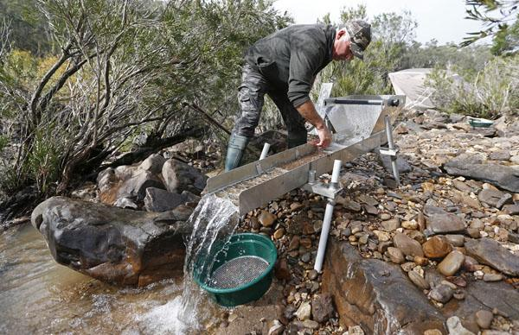
What is Mining ?
We are given this!
We want to find this!
We find a way to start processing?

Slide 5
Lifting the Mist
What are the questions?
No exact answers?
Assumptions?
Variation (the same inputs don’t always give us the same answers)
Vast amounts data.
Is it clean?
How do we present our inferences?

Slide 6
Data Analysis
Data Analysis – is a superset of Data Mining that involves :
extracting,
cleaning,
transforming,
modelling and visualization
Data analytics (DA) is the science of examining raw data with the purpose of drawing conclusions about that information.

Slide 7
Data Mining & Data analytics
The Practice of examining large pre-existing databases in order to generate new information.
The process used by organisations to turn raw data into useful information.
Data Mining/Analytics is used in many industries to allow companies and organization to make better business decisions and in the sciences to verify or disprove existing models or theories.

Slide 8
Data Mining
Data Mining – is a systematic and sequential process of identifying and discovering hidden patterns and information in a large dataset. It is also known as Knowledge Discovery in Databases.
The Practice of examining large pre-existing databases to generate new information or new features.

Slide 9
Your Journey in Data Analytics
Statistics
Machine Learning
Now Data Mining & Data analytics
Both Stats and Machine learning are major components but not the only tools.
Data prep, Feature building, feature extraction, handling differing types of data.

Slide 10
What’s needed?
Data Analytics Process
CRISP DM/KDD - Six Steps
Enterprise
Management approach/systems/software
Leadership
Passion and commitment
Targets
Get the right Key Performance Indicators/metrics
Remember, what gets measured gets managed
Communication
Training/visuals

Slide 11
Looking Outside the box
What are other industries doing today what we could do tomorrow
Systems
What do we have, and can we get data from it?
Is our data on different platforms ?
Can we merge our data?
Can we interrogate our data in an intelligent and efficient manner?

Slide 12
Topics covered
Pre-processing data
Continuous data,
Discrete data
Image pre-processing
Text pre-processing
Generalised linear models
Association rule mining
Unsupervised learning(Cluster analysis)

Slide 13
Recommended Software
Python
Free
Open Source constantly updated
Scikit learn, Tensor Flow, Kera, Theano, Numpy, Scipy, Pandas, Matplotlib, Seaborn, Bokeh etc
R
Free
Open Source constantly updated
We will be using R.
SAS/JMP
Academic version
Cloud based
Extremely powerful
SPSS
Free to students
DCU academic version
Weka is a collection of state of the art machine learning algorithms and data pre-processing tools.
Weka Community
Free Downloads

Slide 14
Course Outline
Project 25%
Class assignments every 2 weeks. 6 Weeks
Exam 75% This maybe a lab exam.
Generally, Lab based lectures.
There will be a quest lecture on the 13th February. There will be an exam question on this content in summer or autumn.

Slide 15
Class assessment (25%)
Pick you own dataset:
Make sure it is large enough at least 100,000 records.
Stipulate the questions you want to answer. The dataset must be approved beforehand and marks will be awarded based on difficulty and imagination of the solution.
Rules of engagement:
Every 2 weeks from week 4 onwards we will have a presentation of your progress. The presentations will be no more than 10 minutes long. 2% will be awarded on each presenting weeks presentation. Relate it to the material you are learning if appropriate and don’t be afraid to read ahead.
The aim of the project is to help you incorporate the lecture material with your project and to keep on top of the work without falling behind.

Slide 16
Class Assignment cont’d
Get into groups of 4 people with the exception of CA683I.
You need to get your project approved by me.
So put your project title and data source in the CA683_Class_list file.
Every two weeks rando groups will be asked up to present the progress of their work. If the group is not represented they will forfeit 2%.

Slide 17
Conclusion
Follow the 6 steps
Always question the data
Where did it come from
How was it measured?
Is the data stable?
Examine outliers/unusual events
Understanding the problem always takes away the mist.
Communication is key to success.
Organisation needs a culture/ Leadership to succeed in analytics.

